Slide 1
Android App Development 1

Slide 2
Course Overview
Wk | Topic
1 | Intro + single-screen apps
1 | Activity Lifecycle + saving activity state
2 | Menus and themes
2 | Multi-screen apps
2 | Fragments
Wk | Topic
3 | Reading XML files + Asynch Tasks
3 | List Views
3 | SQLite Database
4 | Consuming a web service
4 | Geolocation

Slide 3
About me
BSEE from PSU, MA in Linguistics from U of O
Worked as an EE at TriQuint Semiconductor, then morphed into a software engineer.
Senior software engineer at Axian Inc.
Started Creative CyberSolutions, a software development business
Lane Community College, Computer Information Technology (CIT) faculty since 2009

Slide 4
About you
Which degree are you pursuing?
What mobile devices do you own?
Programming experience?
Notes:
Take roll

Slide 5
Introduction
In the next few slides we will discuss:
Why learn to do mobile app development?
Why Android?
How is mobile app development different from other types of development?
What tools and frameworks can be used for mobile app development?
Notes:
This is the outline for today’s session
(Answers

Slide 6
Why learn mobile app development?
What reasons can you think of?
Notes:
Pop up the Collaborate whiteboard

Slide 7
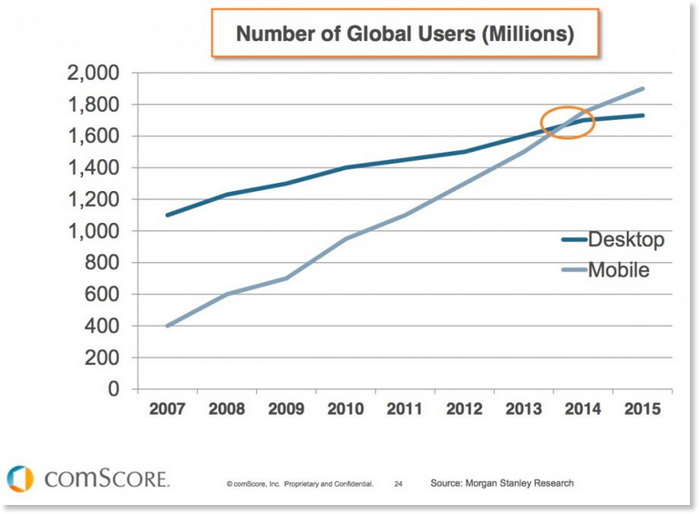
Why learn mobile app development? 1. Business opportunity
Mobile users outnumber desktop users
Notes:
In 2010, Steve Jobs famously announced the beginning of the “post-PC era”.

Slide 8
Why learn mobile app development?
2. It’s fun and interesting
What is fun and interesting about it to you?

Slide 9
Why learn mobile app development? 2. It’s fun and interesting
Mobile apps are more “personal”. They go with you everywhere
Mobile devices have useful sensors: geolocation, temperature, accelerometers, touch, etc.
Mobile phone apps can incorporate communication features

Slide 10
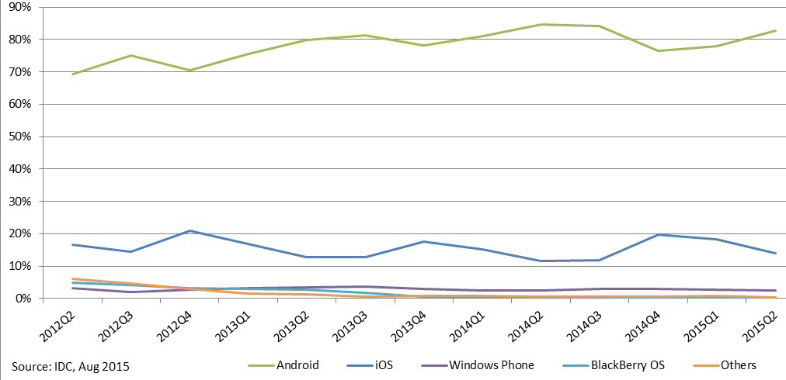
Why learn Android app development?
Android users outnumber iOS users
Units shipped, source: IDC
Notes:
Up to date data: http://www.netmarketshare.com/

Slide 11
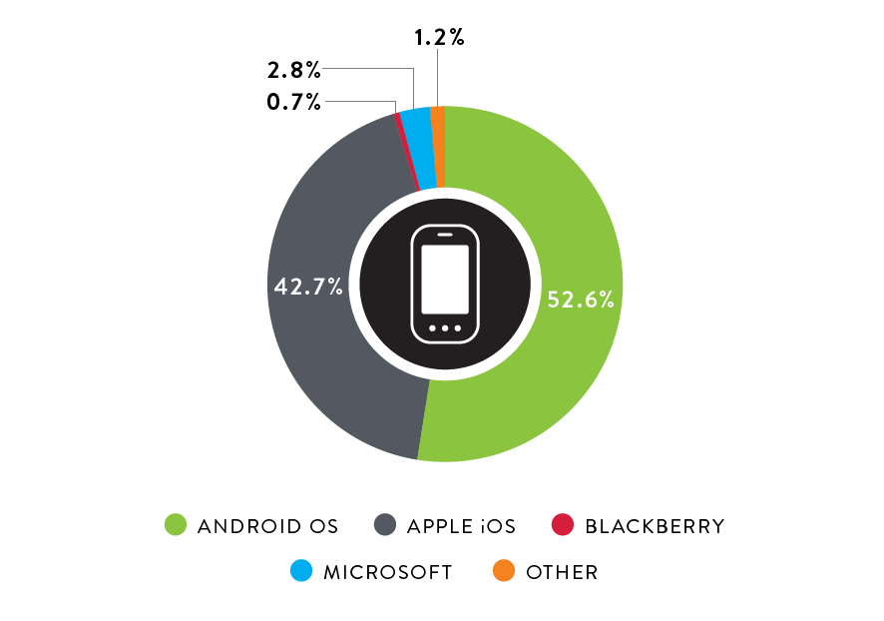
Market Share of US Smartphone Operating Systems in Q3, 2015
Source: The Nielson Company, 12/17/2015

Slide 12
How is mobile app development different from other types of development?
What differences can you think of? (From a developer’s perspective)
Notes:
This is the outline for today’s session

Slide 13
Differences between desktop and mobile development
Low power devices require apps that use less memory and processor power.
Small screens and a wide variety of form factors and screen rotation require flexible UI designs
Lack of true multi-tasking requires different app lifecycle management (this is changing)
A wide variety of sensors can be used by the app.
Connectivity to the internet is not always assured- apps need to handle intermittent connectivity.
Users have higher expectations for responsiveness of the UI.

Slide 14
Development environments
iOS: Objective C or Swift using X-Code
Android: Java or Kotlin using Android Studio (intelliJ)
Cross-platform
HTML5 & JavaScript: Apache Cordova (Phone-gap, etc.), Ionic, React Native, etc.
Full app runs on iOS and Android
C#, .and NET with Xamarin:
Windows, Linux (limited), Mac OS, iOS, and Android
Native UIs: All code except the UI is portable
Xamarin Forms (XAML): The whole app is portable
Dart with Flutter
Requires Flutter app engine
Full app runs on Android and iOS

Slide 15
Syllabus
Let’s look at the syllabus together.
It’s available on Canvas

Slide 16
Reading and Labs
Let’s look at this week’s assignments on Canvas.

Slide 17
Environment for Android App Development
The Android Studio installer will install everything needed:
Java SDK (if it isn’t already installed)
Android SDK
Android Studio IDE based on IntelliJ IDEA by JetBrains

Slide 18
Testing and Emulators for Android
Android Debug Bridge (part of the Android SDK)
Connects the IDE to a device or Emulator
Google Emulator (part of the Android SDK)
Notoriously slow unless you use Haxm (Hardware Acceleration Manager)
Intel Haxm
Downloadable via the Android SDK Manager
GenyMotion
https://www.genymotion.com/pricing-and-licensing
The Individual, Basic plan is free
Actual Android device

Slide 19
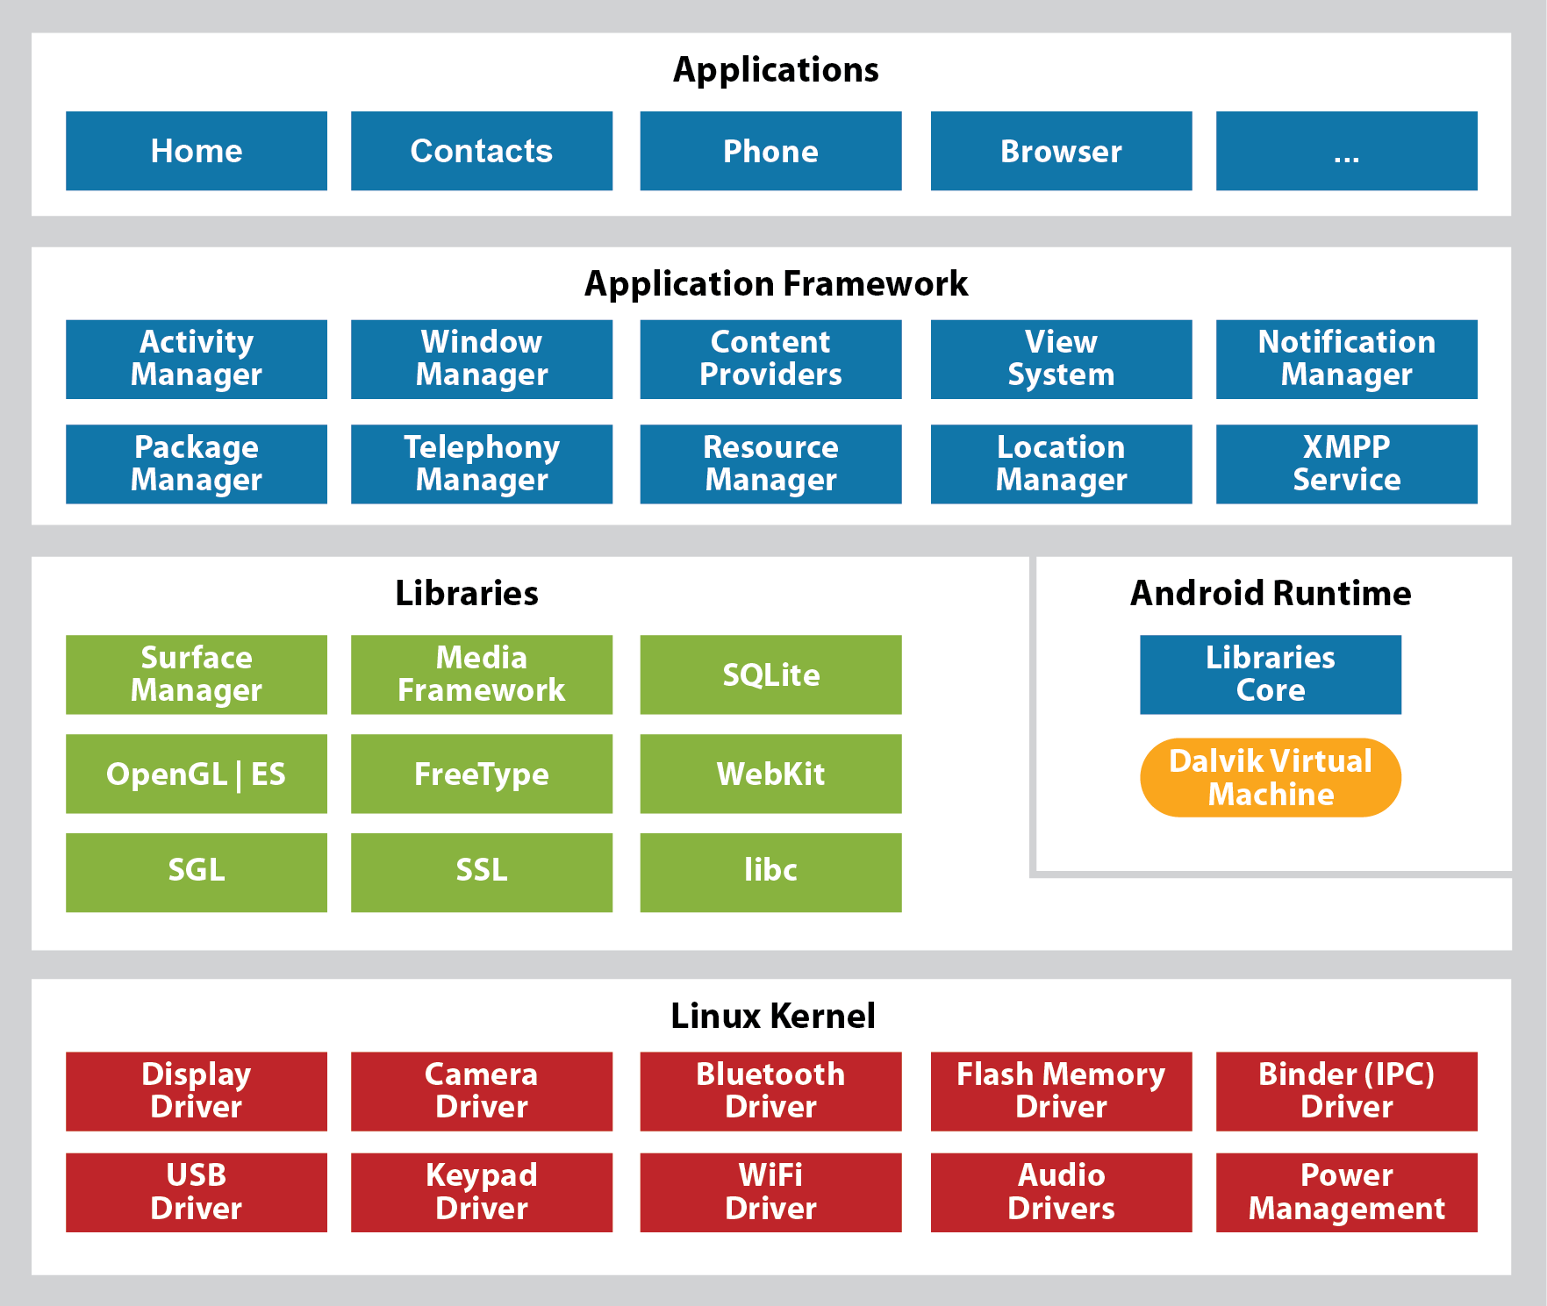
Android Stack
Murach's Android Programming (2nd Ed.), C1
Notes:
The Dalvik VM was replaced by ART (Android Runtime) in Android 4.4, KitKat.
Some framework libraries, like Location Manager are deprecated in favor of packages in Google Play Services

Slide 20
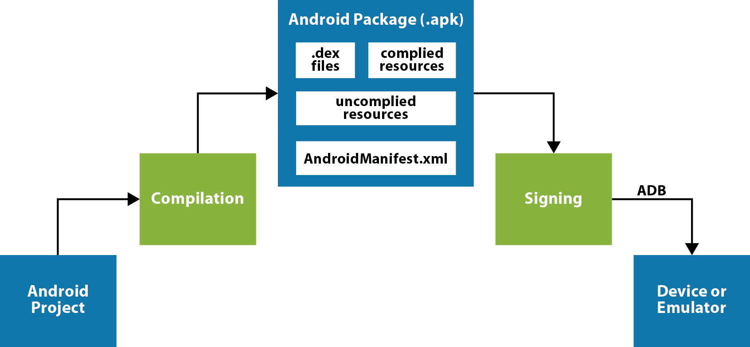
Application Development Work-Flow
Murach's Android Programming (2nd Ed.), C1
Notes:
This same graphic has a misleading title in the textbook

Slide 21
Exercise: Install Android Studio
Download and install Android Studio from: https://developer.android.com/studio/
Available for:
OS X
Windows
Linux

Slide 22
Tour: The Android SDK
In the Android Studio menu, click on:
Tools
Android
SDK Manager
Read about the Android SDK here: https://developer.android.com/studio/intro/update.html#sdk-manager

Slide 23
Exercise: Configure an Emulator
In the Android Studio menu, click on:
Tools
Android
AVDManager
Read the AVD Configuration guide here: https://developer.android.com/studio/run/managing-avds.html
Notes:
https://developer.android.com/studio/run/managing-avds.html

Slide 24
Exercise: Build and Run an App
Download the textbook apps and exercises from www.murach.com/shop/murach-s-android-programming-2nd-edition-detail
Open the Ch. 3 Tip Calculator project in Android Studio (builds automatically)
Run the app on an emulator
Run the app on a physical device
How to enable developer mode: birdsbits.wordpress.com/2014/10/02/how-to-enable-developer-mode-on-an-android-device

